Slide 1



Day 07
contact@anubhavtrainings.com
ABAP RESTFUL APPLICATION PROGRAMMING

Slide 2

Agenda – Day 07
Deploy Fiori App to S/4HANA On-premise using VS Code
What’s new in Fiori Launchpad for S/4HANA On-premise
Create Launchpad content in S/4HANA
Manage App in Launchpad spaces and pages
What is git and git HUB
Working with git
ABAP git scenario
Working with Analytic List Page
Working with OVP Application
Cross App navigation from OVP

Slide 3
Julie
VSCode/BAS
Fiori Launchpad Designer
/n/UI2/FLPD_CONF
Joe
Fiori Developer /RAP developer
Mark
Fiori Security Consultants/ Basis
deploy
SAP Fiori Launchpad
/n/UI2/FLP
Dev
Qlt
Prod
BSP App

Slide 4
Intent = Semantic Object + action
SalesOrder-manage, TravelRequest-create
Catalog
Tiles
Tiles
Tiles
Tiles
Tiles
Tiles
Role
Tiles
Target Mapping
intent
Profile
Profile
Profile
Profile
Profile
Group
Tiles
Tiles
Tiles
Tiles

Slide 5
If you have developed 500 apps, you will have 500 URLs, will you share all URL over email with end users?
Also, will you develop a login screen for every app to check if its valid SAP user?
We need a single point of access based on role and authorizations in the company.
Open the launchpad designer tool /n/UI2/FLPD_CONF
Click settings icon and choose a package and Transport request
Create a new catalog - ZBKL_XX_BC_TRAVEL
Create a new tile, provide title, description, keyword, icon, service url for count, semantic object, action
Create a new target mapping, enter details of Fiori app
Create new group
Reference tile from catalog to group - ZBKL_XX_BCG_TRAVEL
Now we go to PFCG, create new role ZBKL_XX_BR_APPROVER
Go to menu and add Launchpad Catalog and Group
Generate profile
Add user and click user compare button
Go Testing

Slide 6

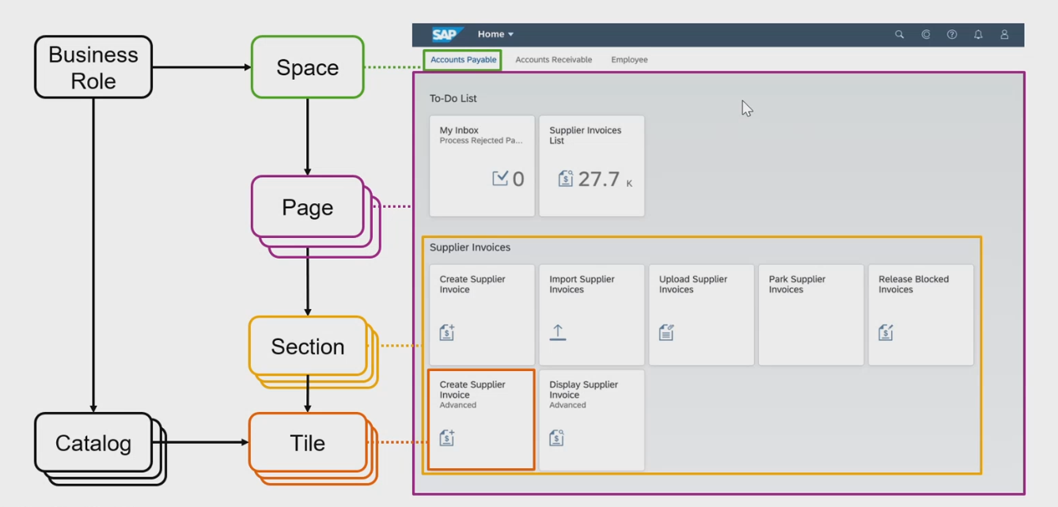
New Launchpad Structure
www.anubhavtrainings.com

Slide 7
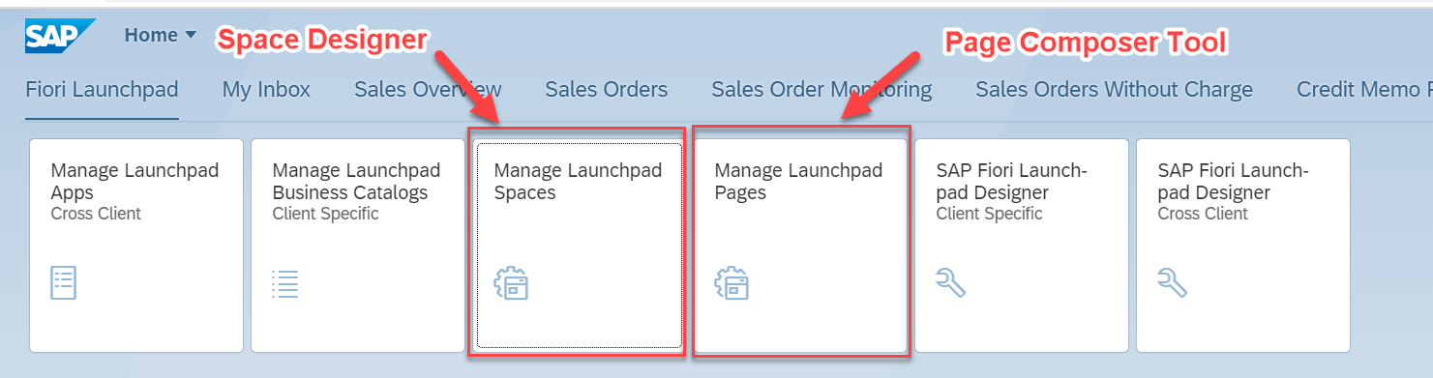
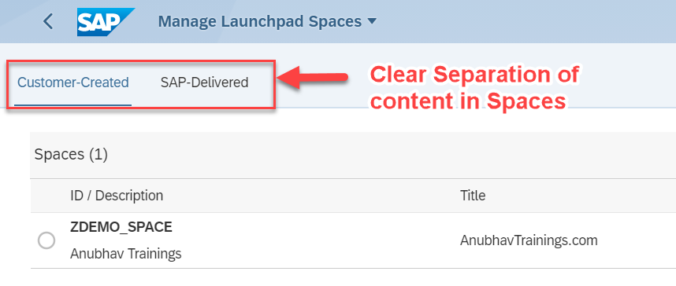
The new Tiles with S/4HANA 2020 – SAP_FLP_ADMIN
www.anubhavtrainings.com

Slide 8
S/4HANA2020- LPD is deprecated
Page composer and Space Designer
SAP_FLP_ADMIN
Fiori Launchpad
Maintenance of groups
SAP Fiori Launchpad
Designer
/n/UI2/FLPD_CONF
Maintenance of Business Catalog
FLP Content Manager
/UI2/FLPCM_CONF
/UI2/FLPCM_CUST
Maintenance of Technical Catalog
Tiles and Target Mappings
Fiori App Manager (earlier named as mass maintenance tool)
/n/UI2/FLPAM
www.anubhavtrainings.com

Slide 9
Last night I was working with my code and it was very stable, today morning I had fight with my wife, come office and messed up something. Now I pray to god to go back to last stable state? A develop need versioning of their code in local machine.
In multi-developer environment, we need to sync the code between developers and also identify who’s code disrupted the solution.
If new resources joins the team, we want them to get on-boarded quickly.
Git / Perforce / GitLab / Big Bucket

Slide 10

What is Git ?
Git is a free and open source distributed version control system designed to handle everything from small to very large projects with speed and efficiency.
Git is easy to learn and has a tiny footprint with lightning fast performance. It outclasses SCM tools like Subversion, CVS, Perforce, and ClearCase with features like cheap local branching, convenient staging areas, and multiple workflows.

Slide 11


Git and Git HUB
The git is a distributed repository management system and git hub is a repository which stores our code online.
Install git in our system from here check via command git --help
Mike
(Fiori Developer)
Julie
(Fiori Developer)
VS Code
BAS
git clone <REPO>
project
project
git init
git add . / git add <filename>
git commit –m <change text>
git push
git add . / git add <filename>
git commit –m <change text>
git push
02f35e2
Local git repository
Local git repository
GitHUB
REMOTE Repository
project
ab43f94
project
branch
master
git reset <commitid>

Slide 12
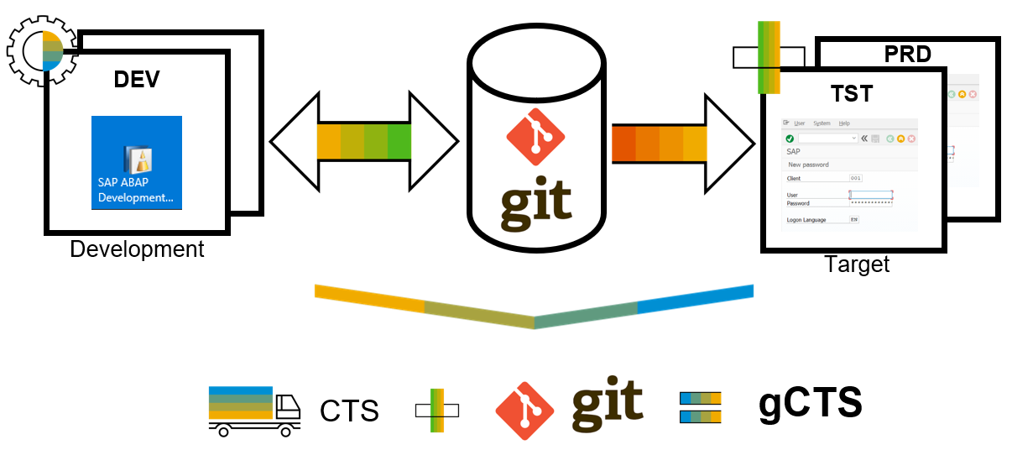
What is ABAP Git ?
abapGit is a tool to import and export code between ABAP systems. If a developer has a developer key to the system, the developer can perform these actions already. abapGit enables the developer to do mass export/changes/imports but not more than already possible to do manually.
Running automated security checks on the abapGit code will by design give a lot of errors, as abapGit will import, overwrite and change ABAP artifacts in the system in ways that might not be intended. Always review all code in remote repositories before importing to the target system, this is possible because abapGit is plain text unlike traditional transport files.
That being said, abapGit is used by mutiple organizations, all abapGit changes are reviewed via pull requests. And all 100+ repository watchers are automatically notified for every change to the code base, so potentially all changes are looked at by more people than tradtional enterprise products.

Slide 13
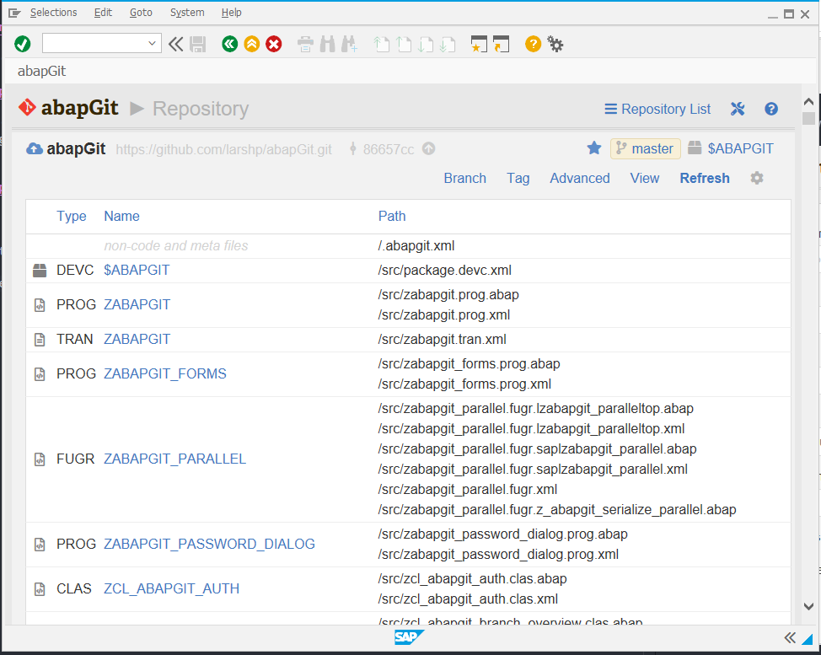
ABAP Git
It is a community effort to support the project, recommend watching the project to get a feeling about issue resolution. Everyone can suggest changes to abapGit via pull requests.

Slide 14
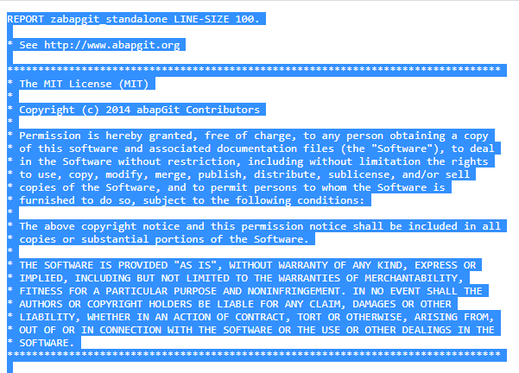
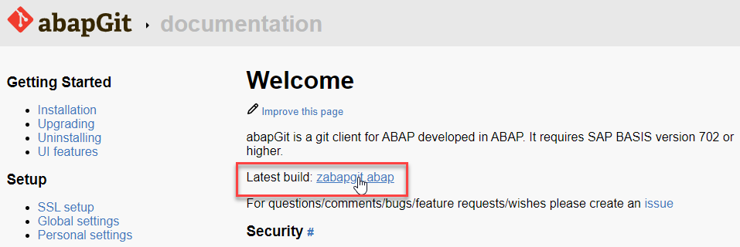
ABAP Git Integration
Step 1. Go to https://docs.abapgit.org/ in browser and click on Latest Build.
Step 2. Copy this Code.

Slide 15
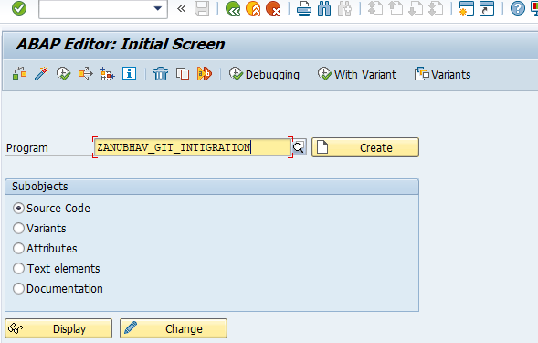
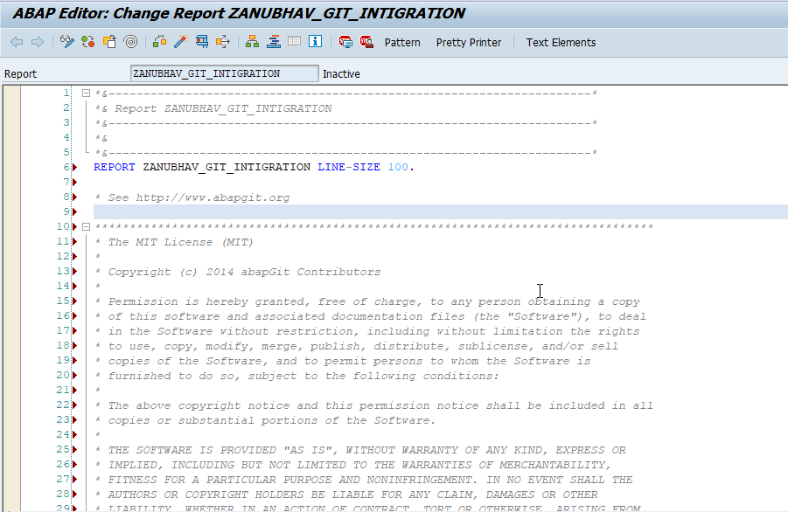
ABAP Git Integration
Step 3. Open SAP Gui Go to T-Code SE38 for Building Report, give any name to report and click on create.
Step 4. Paste the Copied Copy in this report.

Slide 16
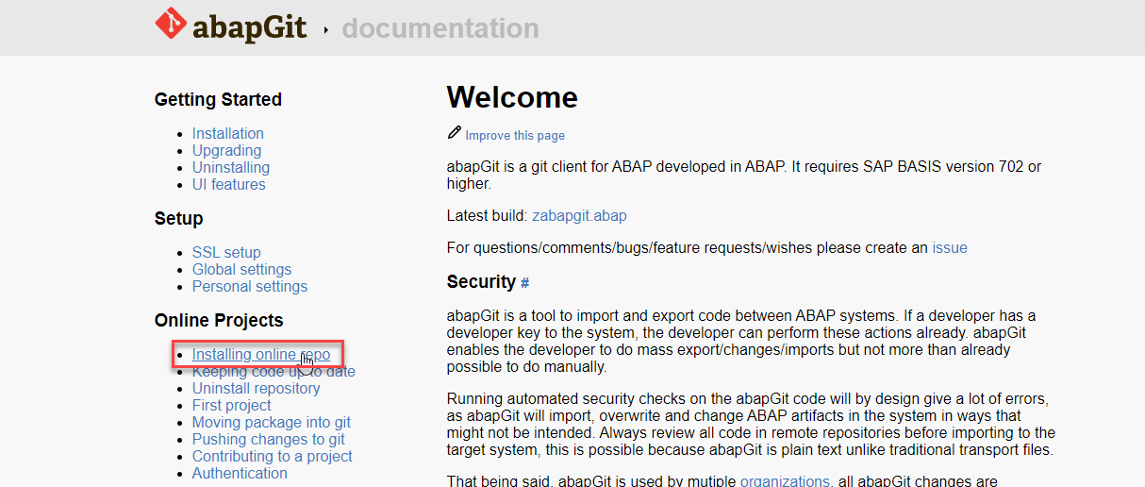
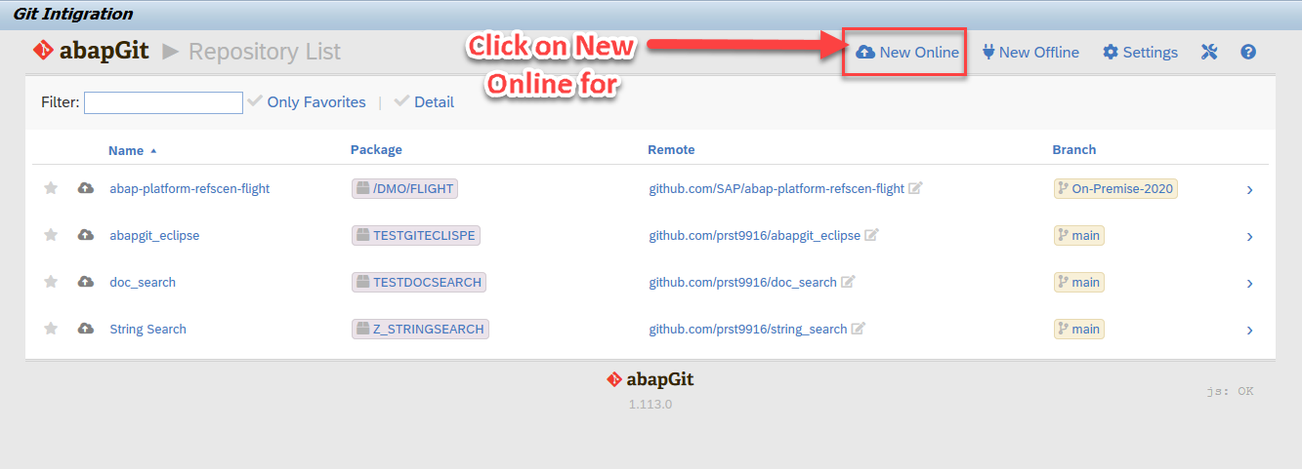
ABAP Git Integration
Step 5. After the Execution, abapGit Screen
Step 6. Go back to Bowser side and click on Installing Online Repo

Slide 17
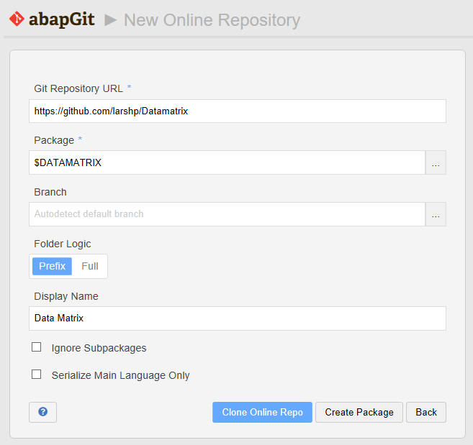
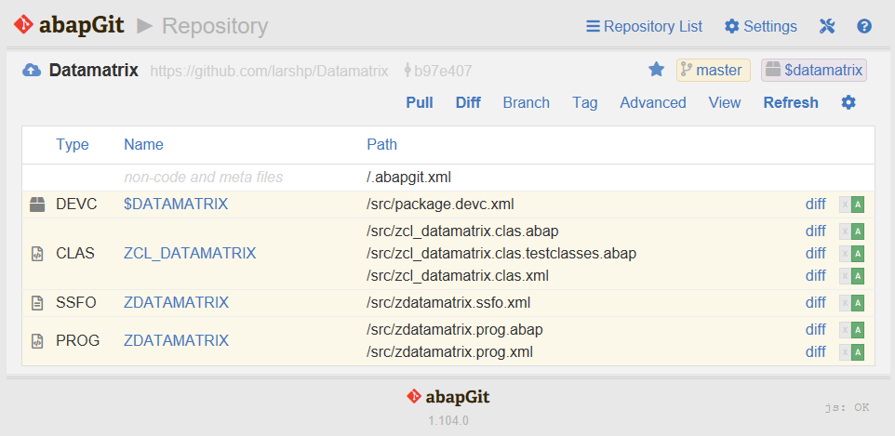
ABAP Git Integration
Step 7. Enter the url for the Github project, eg https://github.com/larshp/Datamatrix along with a package name, eg. $DATAMATRIX. If the package does not exist yet, it will be created automatically when pulling. Alternatively, you can select “Create Package” to create the package manually with your own settings.
Step 8.Select “Clone Online Repo”
Select “Pull” to copy all objects from the Git repository into the SAP system

Slide 18
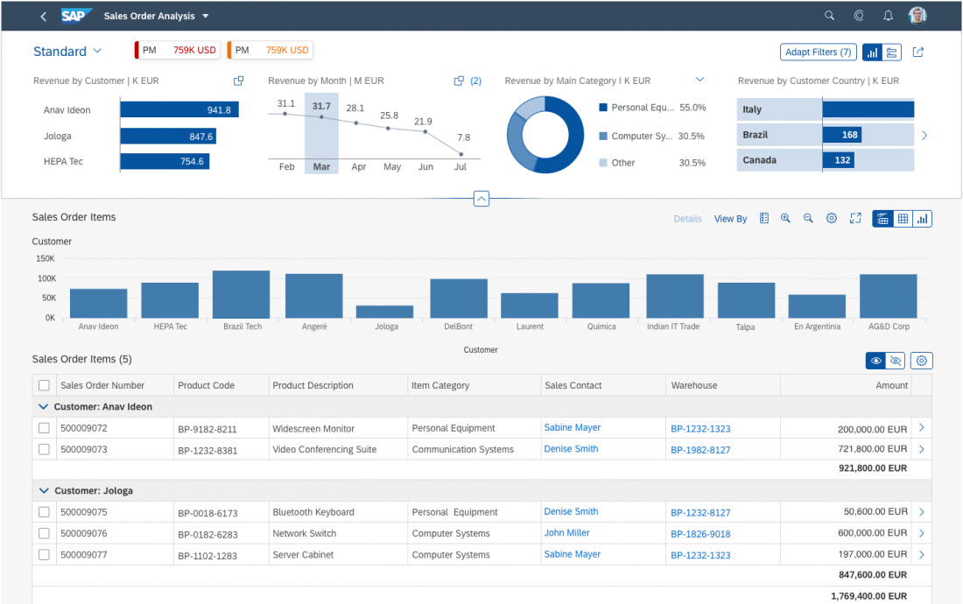
Working with Analytic List Page
The analytical list page (ALP) offers a unique way to analyze data step by step from different perspectives, to investigate a root cause through drilldown, and to act on transactional content. All this can be done seamlessly within one page.
The purpose of the analytical list page is to identify interesting areas within datasets or significant single instances using data visualization and business intelligence.
Visualizations help users to recognize facts and situations, and reduce the number of interaction steps needed to gain insights or to identify significant single instances. Chart visualization increases the joy of use, and enables users to spot relevant data more quickly.

Slide 19
When to use ALP
Users need to extract key information to understand the current situation or identify a root cause. The way the data is presented is crucial for giving them the insights they need to take the right action.
Users need a way to analyze data step by step from different perspectives, investigate a root cause through drilldown, and act on transactional content within one page.
In addition to the filtered dataset, users need to see the impact of their filter settings in a chart (visual filter).
Users need to switch between integrated chart and table views (hybrid view).
Users need to see the impact of their action on a global key performance indicator (KPI).
Users need to find and act on relevant items out of a large set of items by searching, filtering, sorting, grouping, drilling down, and slicing and dicing.

Slide 20
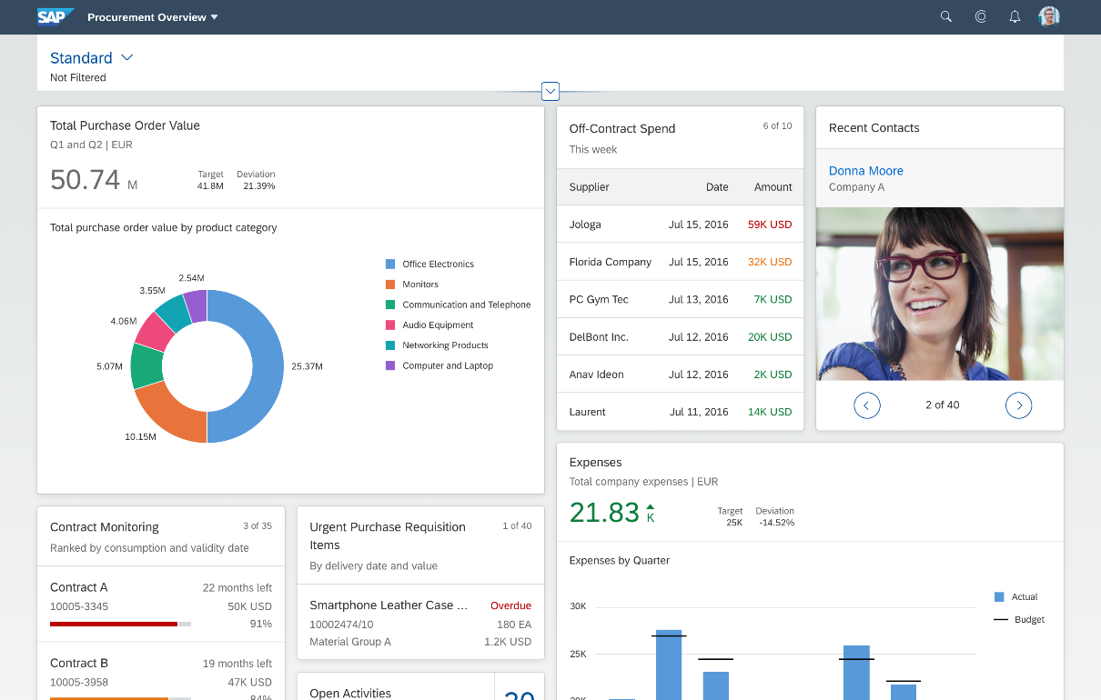
Working with Overview Page (OVP)
The overview page (OVP) is a data-driven SAP Fiori app type and floorplan that provides all the information a user needs in a single page, based on the user’s specific domain or role. It allows the user to focus on the most important tasks, and view, filter, and react to information quickly.
Each task or topic is represented by a card (or content container). The overview page acts as a UI framework for organizing multiple cards on a single page.
The overview page is based on SAP Fiori elements technology, and uses annotated views of app data, meaning that the app content can be tailored to the domain or role. Different types of card allow you to visualize information in an attractive and efficient way.

Slide 21
When to use OVP
You want to provide an entry-level view of content related to a specific domain or role.
Users needs to filter and react to information from at least two different applications to complete their role-specific tasks.
You want to offer different information formats (such as charts, lists, and tables) on a single page.
You plan to have at least three cards. These cards should not all be of the same type.

Slide 22

End of Day 07
Trainer: Anubhav Oberoy

Slide 23
Trainer: Anubhav Oberoy

Slide 24
THANK YOU
If you cannot do
great things, do small things in a great way.
Anubhav Oberoy
https://www.anubhavtrainings.com

Slide 25


We’re committed to empower you to be
Most Desirable Resource
through powerful training solutions.
We build the workforce of the future.
250+
Corporate Clients
30,000+
Learners Trained
25000+
Learners Placed
FREE WEBINARS
Sign up for free webinars with industry experts every fortnight!
Enroll Now!
Contact us today!
https://anubhavtrainings.com/

Slide 26




More from AnubhavTrainings.com

